Slide 1
Thank you for downloading this freebie! If you have any questions or problems please email me at lessonsforlittleones@gmail.com.
If you would like ready-made, time-saving centers for your kindergarten classroom, click the links below to download some classroom-tested kindergarten centers.
Sorting Activities
Alphabet & Phonics
STEM Activities
Math Games
Sight Words
© 2021 Lessons for Little Ones by Tina O’Block

Slide 2
Directions
Student Name Cards
There are 2 options from which to choose for the student cards:
You can type student names on page 3.
Click inside each text box, delete the words “Student Name”, and type the student’s name.
You can insert student photos on page 4.
To insert each photo, click Insert-Pictures-This Device. Browse to the place on your computer where your students’ photos are stored, select a photo, and click Open.
Resize the photo and move it in a square.
Center Cards
The center cards come in 3 colors (green, blue, yellow) so that you can use a different color for each of your center rotations if desired.
The text above the pictures is editable. Click inside each text box, delete the words “Enter Text”, and type the center’s name.
There are a number of pictures included for different types of centers. Suggestions for each set:
Set 1 – small groups and independent activity or page
Set 2 – listening center and reading
Set 3 – technology and pocket chart
Set 4 – play dough and magnetic letters or literacy center
Set 5 – partner game or game and puzzles
Set 6 – blocks and science
Edit and print the center cards of your choice. Click File-Print. Under Settings, change “Print All Slides” to either “Print Current Slide” OR “Custom Range” and add the slide numbers.
© 2021 Lessons for Little Ones by Tina O’Block

Slide 3
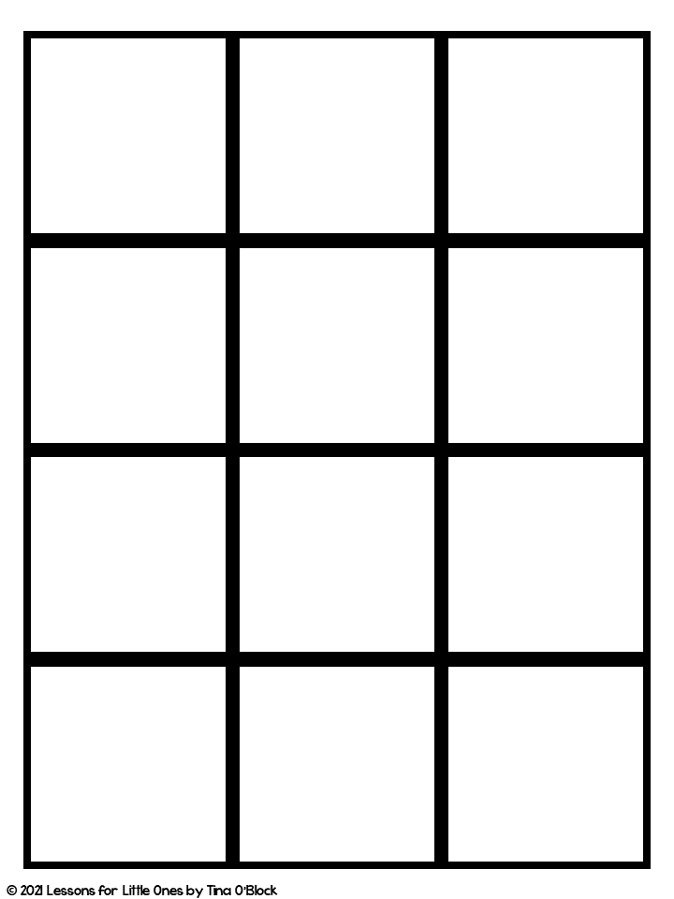
Student
Name
Student
Name
Student
Name
Student
Name
Student
Name
Student
Name
Student
Name
Student
Name
Student
Name
Student
Name
Student
Name
Student
Name

Slide 4
Insert
Student
Photo
Insert
Student
Photo
Insert
Student
Photo
Insert
Student
Photo
Insert
Student
Photo
Insert
Student
Photo
Insert
Student
Photo
Insert
Student
Photo
Insert
Student
Photo
Insert
Student
Photo
Insert
Student
Photo
Insert
Student
Photo

Slide 5
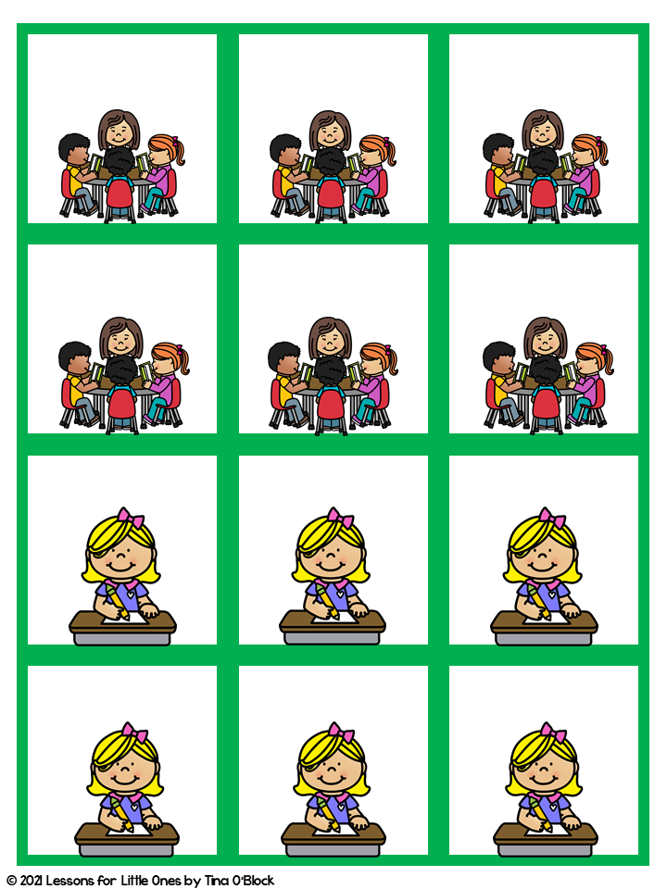
Enter Text
Enter Text
Enter Text
Enter Text
Enter Text
Enter Text
Enter Text
Enter Text
Enter Text
Enter Text
Enter Text
Enter Text

Slide 6
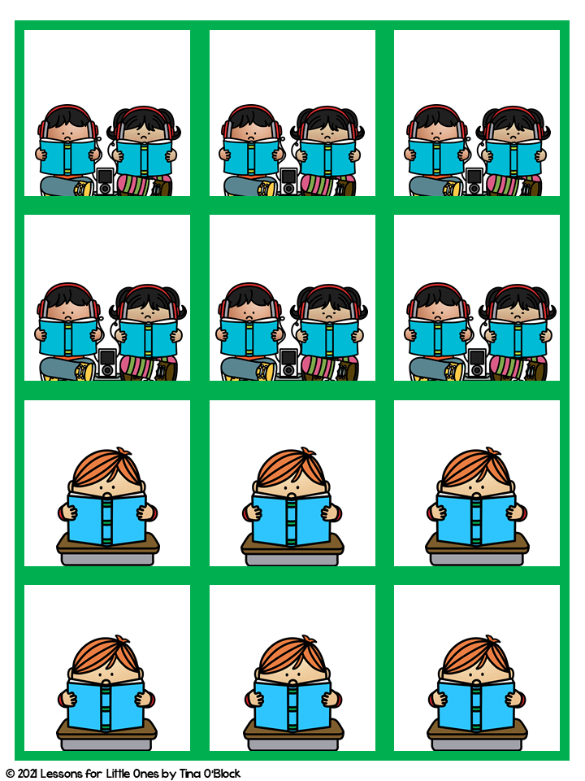
Enter Text
Enter Text
Enter Text
Enter Text
Enter Text
Enter Text
Enter Text
Enter Text
Enter Text
Enter Text
Enter Text
Enter Text

Slide 7
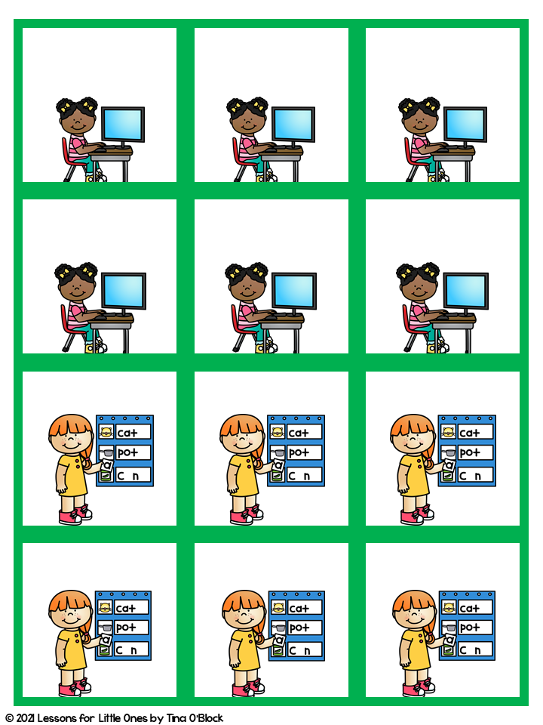
Enter Text
Enter Text
Enter Text
Enter Text
Enter Text
Enter Text
Enter Text
Enter Text
Enter Text
Enter Text
Enter Text
Enter Text

Slide 8
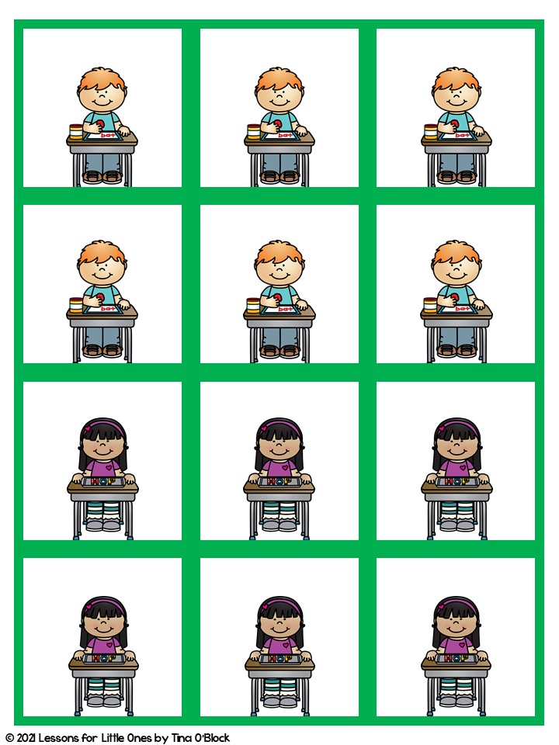
Enter Text
Enter Text
Enter Text
Enter Text
Enter Text
Enter Text
Enter Text
Enter Text
Enter Text
Enter Text
Enter Text
Enter Text

Slide 9
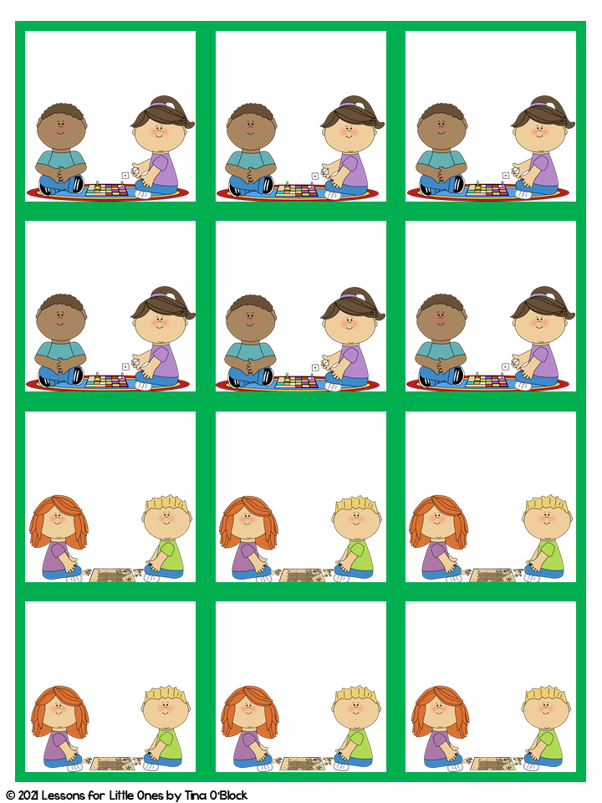
Enter Text
Enter Text
Enter Text
Enter Text
Enter Text
Enter Text
Enter Text
Enter Text
Enter Text
Enter Text
Enter Text
Enter Text

Slide 10
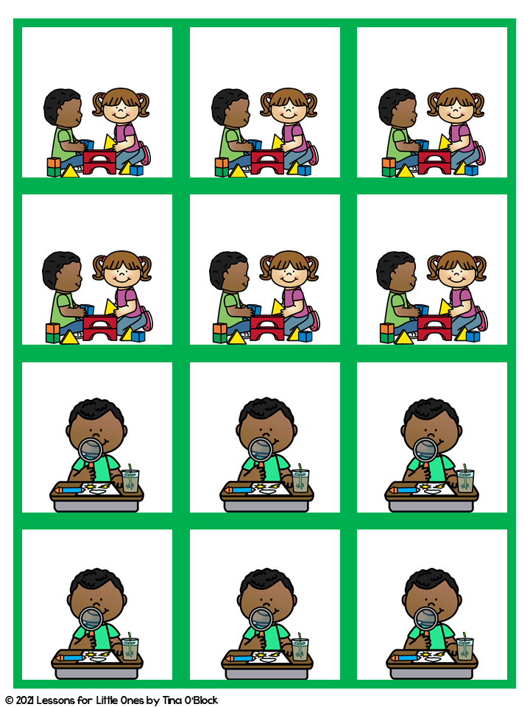
Enter Text
Enter Text
Enter Text
Enter Text
Enter Text
Enter Text
Enter Text
Enter Text
Enter Text
Enter Text
Enter Text
Enter Text

Slide 11
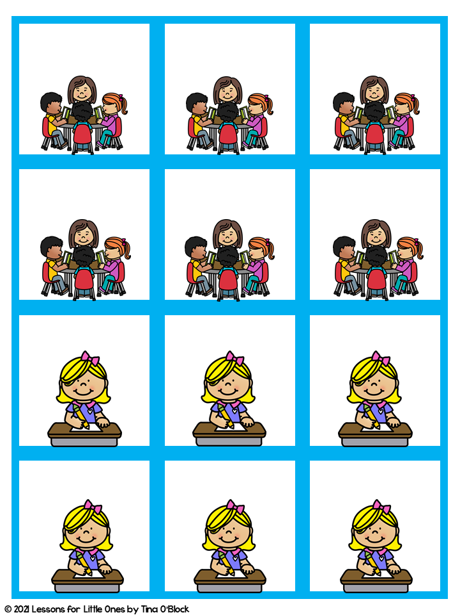
Enter Text
Enter Text
Enter Text
Enter Text
Enter Text
Enter Text
Enter Text
Enter Text
Enter Text
Enter Text
Enter Text
Enter Text

Slide 12
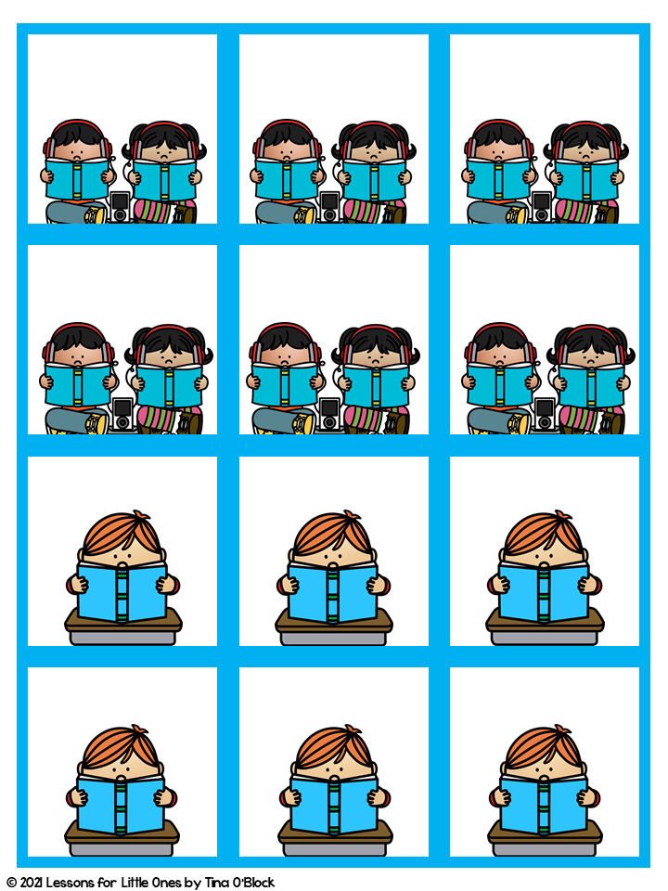
Enter Text
Enter Text
Enter Text
Enter Text
Enter Text
Enter Text
Enter Text
Enter Text
Enter Text
Enter Text
Enter Text
Enter Text

Slide 13
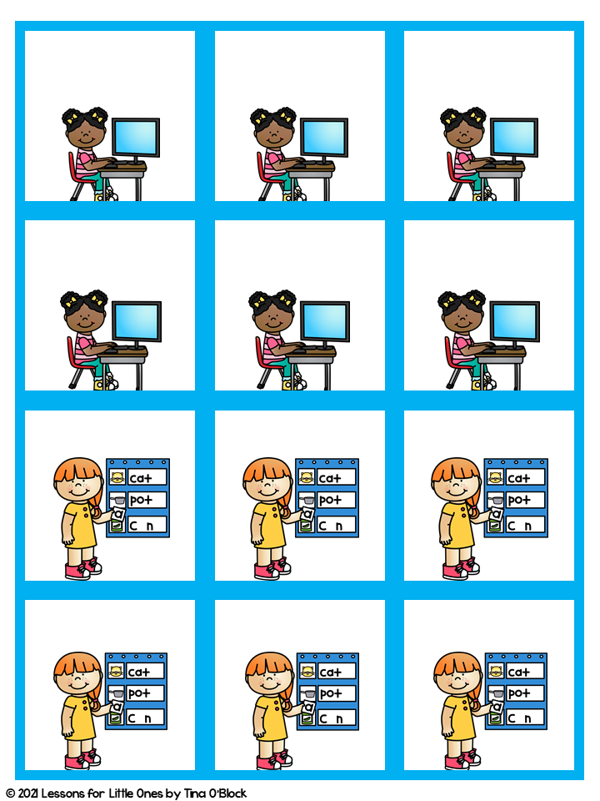
Enter Text
Enter Text
Enter Text
Enter Text
Enter Text
Enter Text
Enter Text
Enter Text
Enter Text
Enter Text
Enter Text
Enter Text

Slide 14
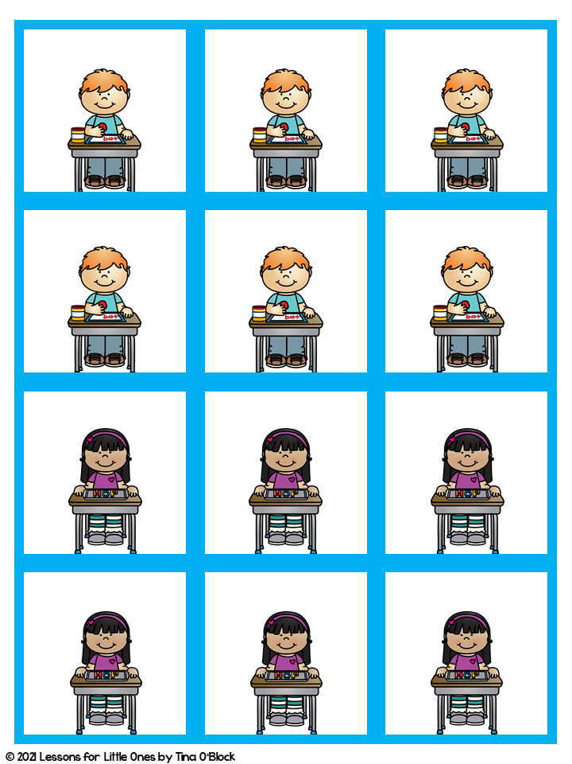
Enter Text
Enter Text
Enter Text
Enter Text
Enter Text
Enter Text
Enter Text
Enter Text
Enter Text
Enter Text
Enter Text
Enter Text

Slide 15
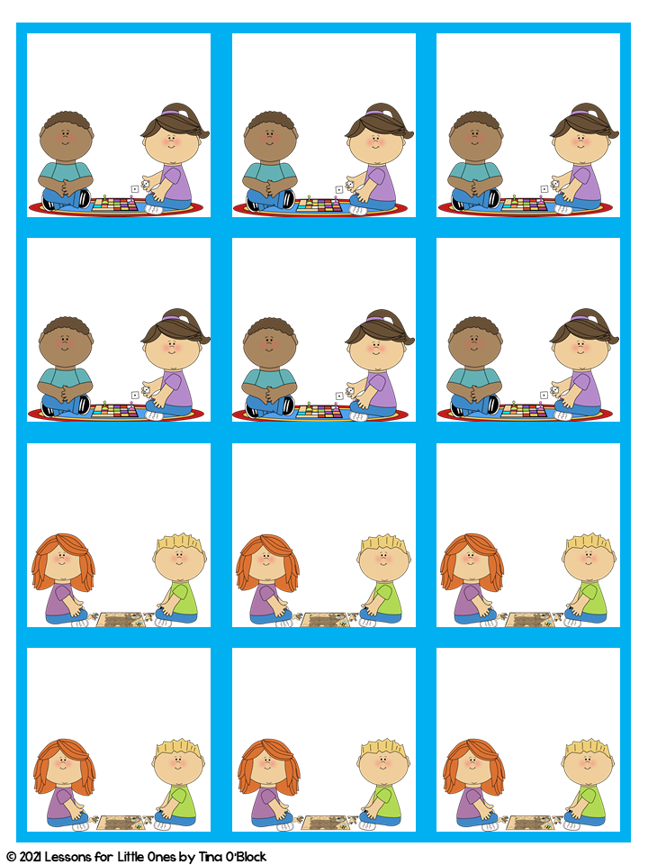
Enter Text
Enter Text
Enter Text
Enter Text
Enter Text
Enter Text
Enter Text
Enter Text
Enter Text
Enter Text
Enter Text
Enter Text

Slide 16
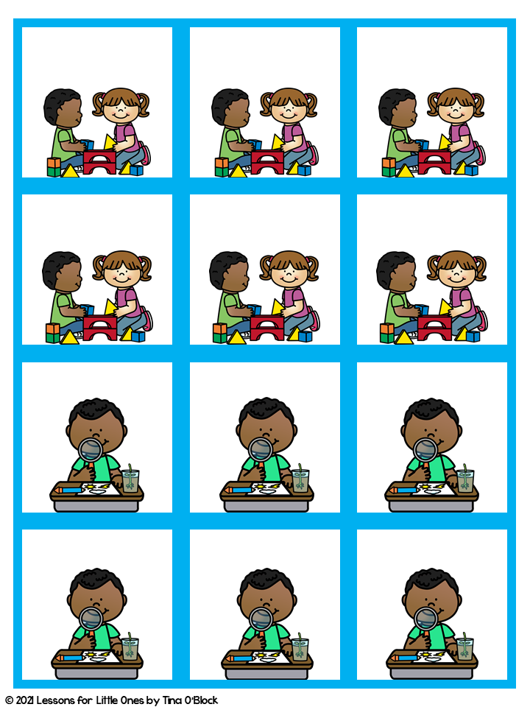
Enter Text
Enter Text
Enter Text
Enter Text
Enter Text
Enter Text
Enter Text
Enter Text
Enter Text
Enter Text
Enter Text
Enter Text

Slide 17
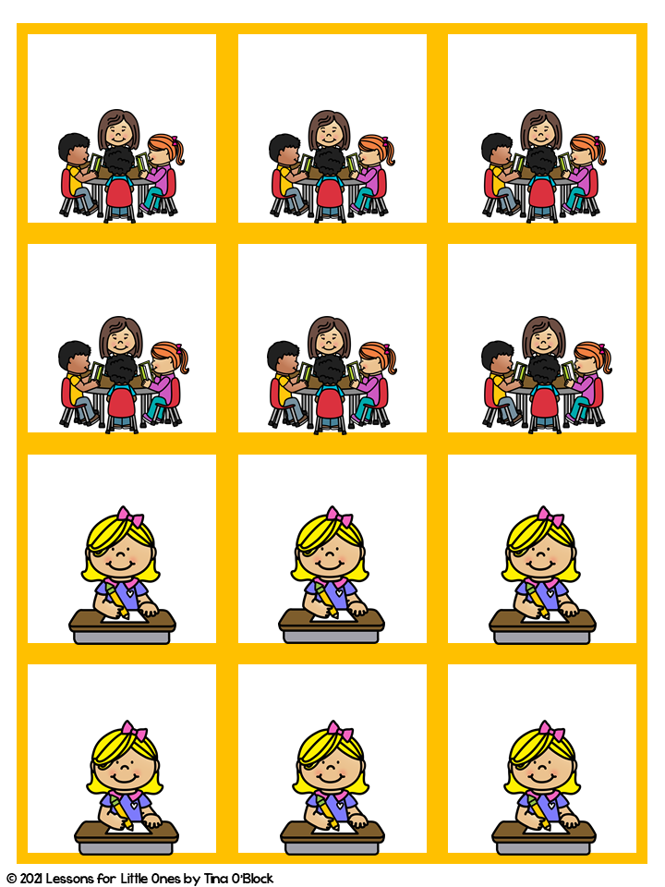
Enter Text
Enter Text
Enter Text
Enter Text
Enter Text
Enter Text
Enter Text
Enter Text
Enter Text
Enter Text
Enter Text
Enter Text

Slide 18
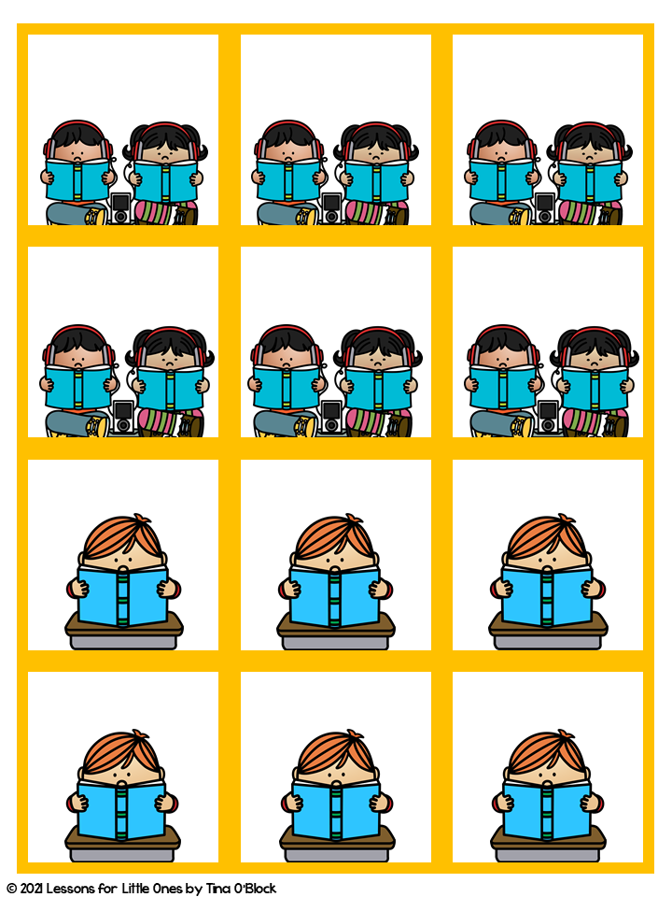
Enter Text
Enter Text
Enter Text
Enter Text
Enter Text
Enter Text
Enter Text
Enter Text
Enter Text
Enter Text
Enter Text
Enter Text

Slide 19
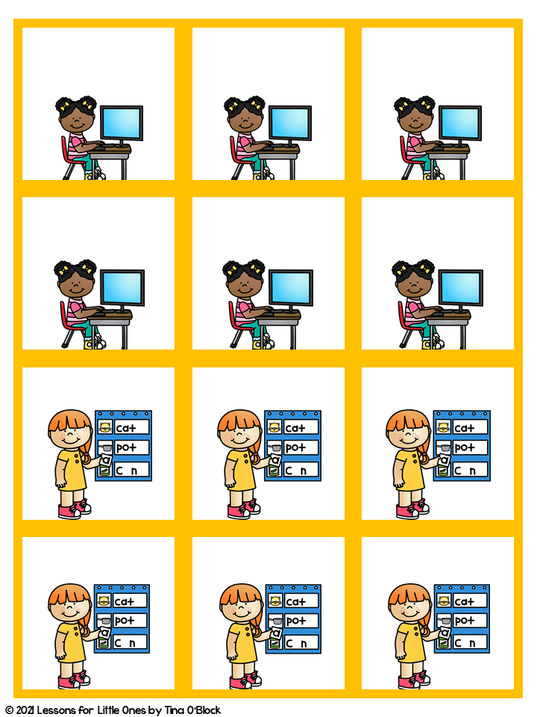
Enter Text
Enter Text
Enter Text
Enter Text
Enter Text
Enter Text
Enter Text
Enter Text
Enter Text
Enter Text
Enter Text
Enter Text

Slide 20
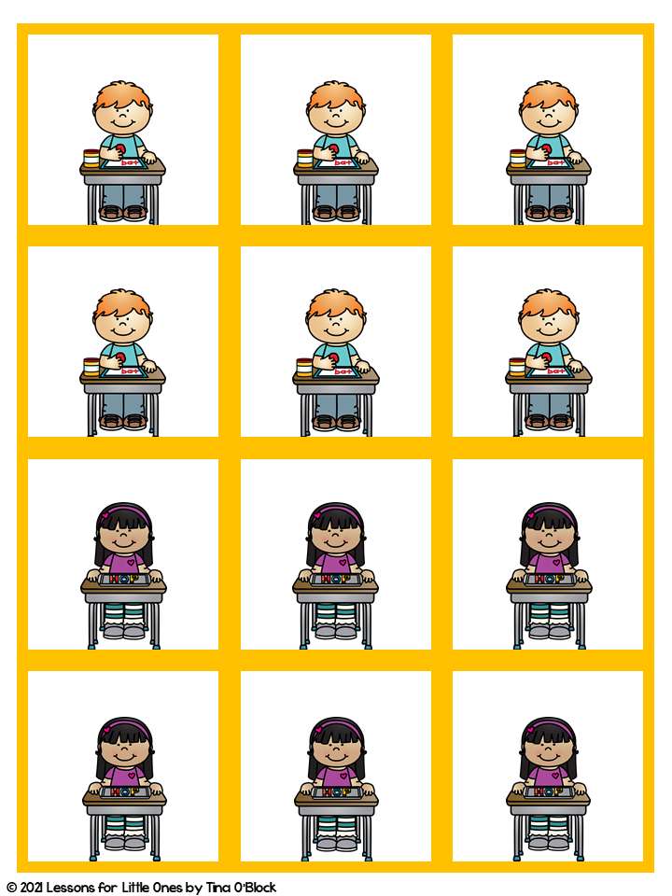
Enter Text
Enter Text
Enter Text
Enter Text
Enter Text
Enter Text
Enter Text
Enter Text
Enter Text
Enter Text
Enter Text
Enter Text

Slide 21
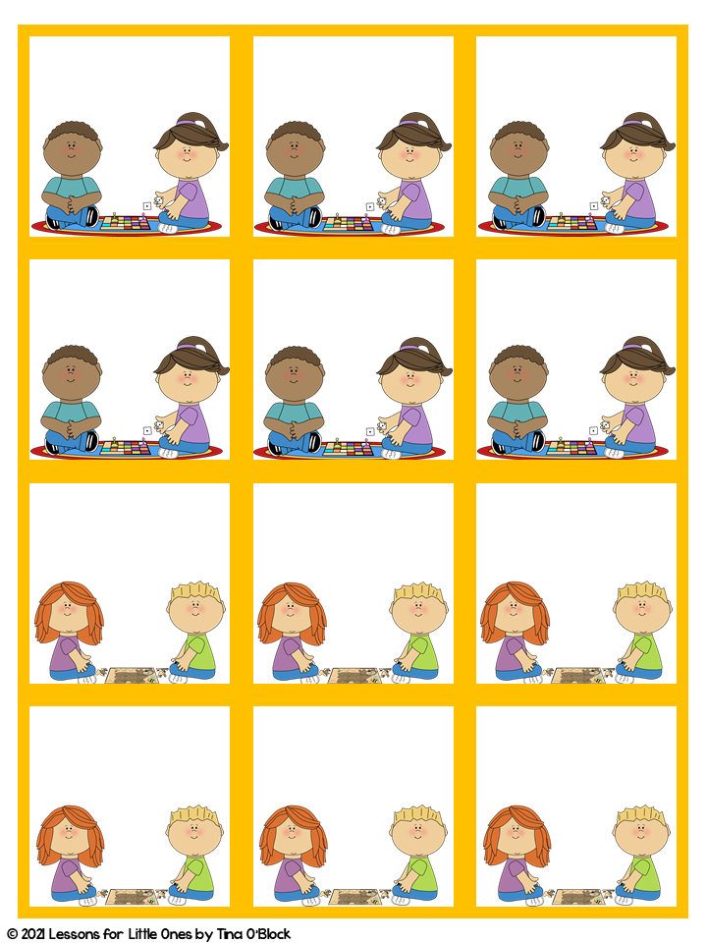
Enter Text
Enter Text
Enter Text
Enter Text
Enter Text
Enter Text
Enter Text
Enter Text
Enter Text
Enter Text
Enter Text
Enter Text

Slide 22
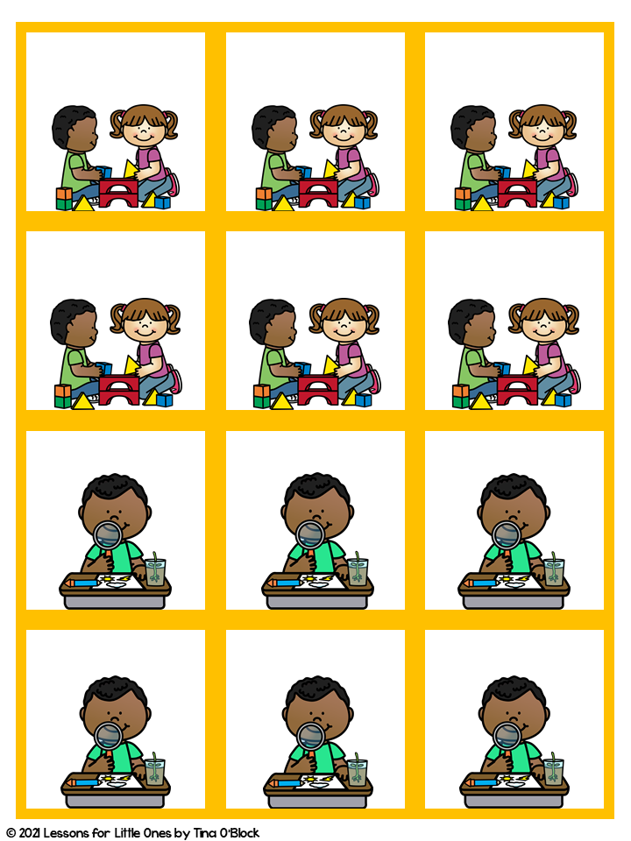
Enter Text
Enter Text
Enter Text
Enter Text
Enter Text
Enter Text
Enter Text
Enter Text
Enter Text
Enter Text
Enter Text
Enter Text

Slide 23




Thank you for your purchase!
Let’s connect!
Thank you for your purchase! I’m so grateful you chose my materials for your classroom!
If you have any questions or run into any issues using this resource, please email me at lessonsforlittleones@gmail.com. I’m always happy to help!
With 22 years of classroom experience, my heart has always been in helping young learners enjoy school and develop a love of learning during their very first classroom experiences. I love supporting teachers as they build strong foundations while keeping learning fun, engaging, and realistic for their classrooms.
I create hands-on, classroom-tested resources designed to reach students at all ability levels and make learning meaningful, enjoyable, and developmentally appropriate. My goal is to help teachers feel confident and supported while helping students feel successful, curious, and excited about learning. I’m honored you chose my materials for your classroom!
- Tina
Follow my store to be the first to know about new resources, freebies, and upcoming sales.
Thank you for respecting my work!
This resource is licensed for use by one teacher in one classroom and may not be shared digitally or distributed outside your classroom.

Slide 24

Thank you for downloading!
Let’s connect!
Thank you for respecting my work!
The following terms help protect this resource so I can continue creating and sharing classroom-tested materials for teachers.
Purchase of this unit grants the buyer a single-teacher license to reproduce pages in limited quantities for use in one classroom only. Duplication for an entire school, an entire school system or commercial purposes is strictly forbidden without written permission from the publisher.
Copying any part of this product and placing it on the Internet in any form (even a personal/classroom website) is strictly forbidden and is a violation of the Digital Millennium Copyright Act (DMCA).
Clip art & Graphics Credits
You may:
Use this item for your own personal or classroom use. This includes printing copies for use in your classroom by your students.
Purchase additional licenses for others at a discount.
Blog or post on social media about the use of the product sharing the COVER PAGE ONLY and you must provide a link for purchase to my store.
You may not:
Copy or give this item to others.
Every page is copyrighted. You may not remove the copyright.
Post this document or any part of it online, including classroom or district websites. Uploading this to the internet is strictly prohibited.
Use this resource for commercial purposes or financial gain.
Offer this resource or any part of it to others for free or for sale.
Follow my store to be the first to know about new resources, freebies, and upcoming sales.

