Slide 1
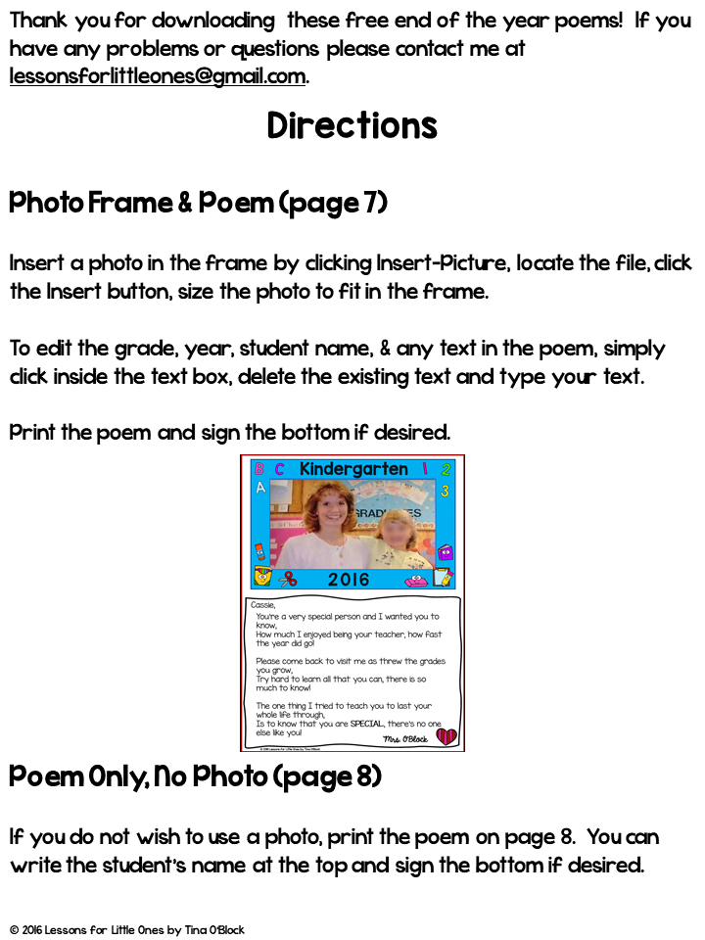
5
Poem Only, No Photo (page 6)
If you do not wish to use a photo, print the poem on page 6 or 7.
You can use the editable version on page 6 to add the student’s name at the top and your name at the bottom OR print page 7 and handwrite/sign it.

Slide 2
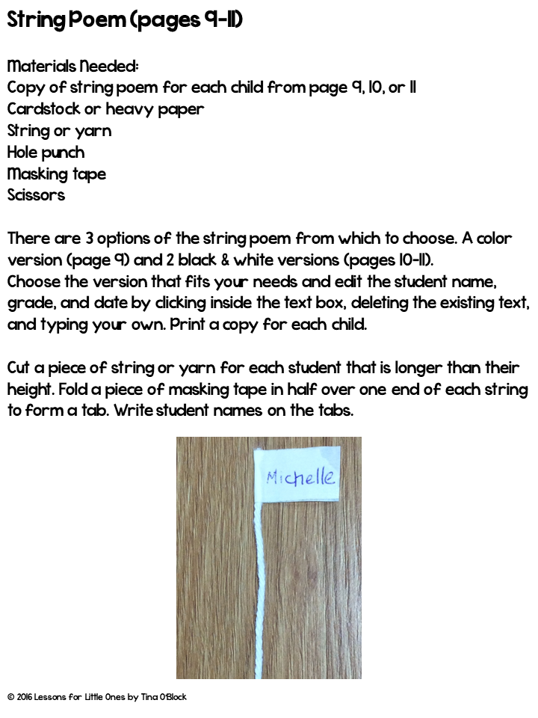
8-10
8, 9, or 10
8
9-10

Slide 3
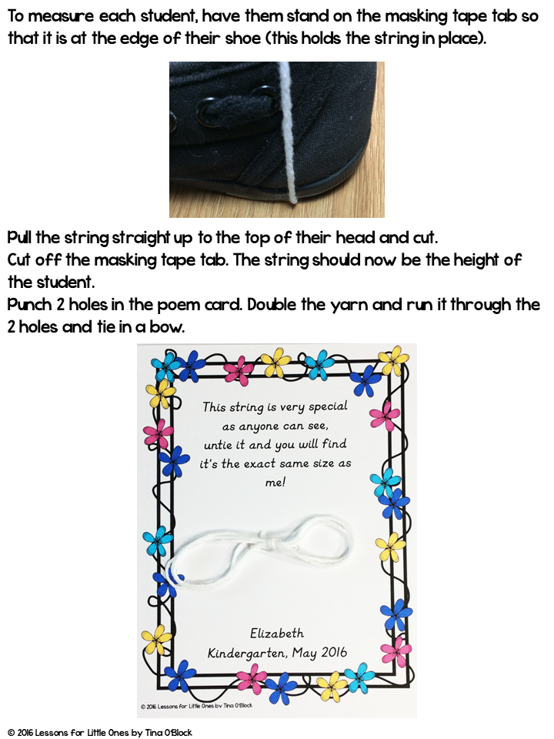

Slide 4
Looking for More End-of-the-Year Ideas?
I hope these poems help make the last few days of school extra special for your students!
If you're looking for more simple, low-prep end-of-the-year activities, I've shared many of my classroom favorites on the blog. You'll find crafts, bulletin board ideas, student gifts, graduation ideas, and more to help you finish the year with less stress and more fun.
🎓 End-of-the-Year Student Gift Ideas
🎓 End of the Year Bulletin Board & Craft Ideas
🎓 How to Set Up a Fun End of the Year Escape Room
🎓 End-of-the-Year & Graduation Celebration Ideas

Slide 5
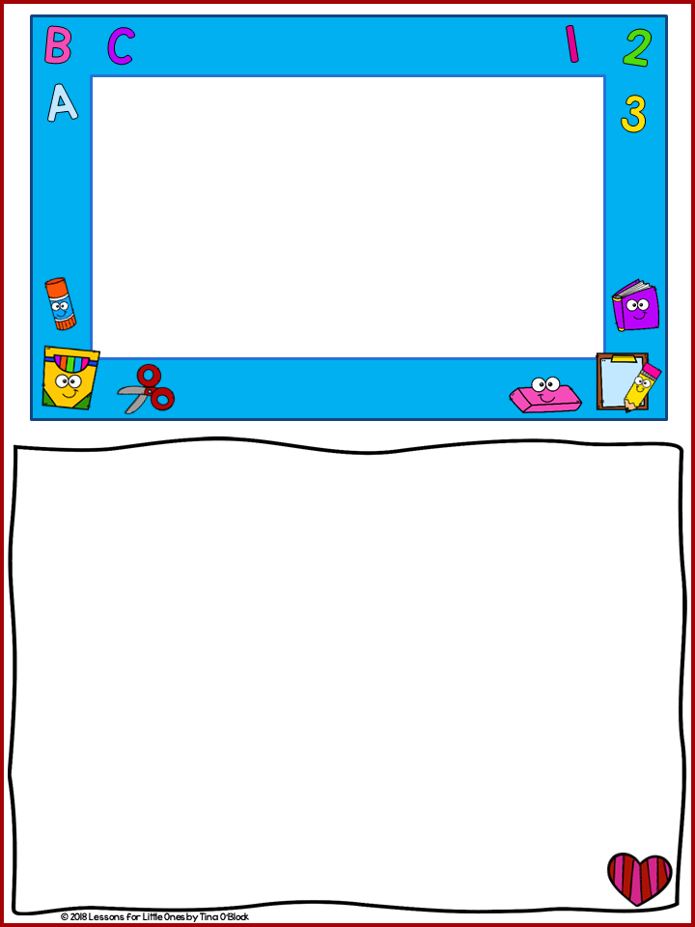
Kindergarten
2026
Student Name,
You’re a very special person and I wanted you to know,
How much I enjoyed being your teacher, how fast the year did go!
Please come back to visit me as through the grades you grow,
Try hard to learn all that you can, there is so much to know!
The one thing I tried to teach you to last your whole life through,
Is to know that you are SPECIAL, there’s no one else like you!

Slide 6

Student Name
You’re a very special person and I wanted you to know,
How much I enjoyed being your teacher, how fast the year did go!
Please come back to visit me as threw the grades you grow,
Try hard to learn all that you can, there is so much to know!
The one thing I tried to teach you to last your whole life through,
Is to know that you are SPECIAL, there’s no one else like you!
Teacher Name
© 2016 Lessons for Little Ones by Tina O’Block

Slide 7
You’re a very special person and I wanted you to know,
How much I enjoyed being your teacher, how fast the year did go!
Please come back to visit me as threw the grades you grow,
Try hard to learn all that you can, there is so much to know!
The one thing I tried to teach you to last your whole life through,
Is to know that you are SPECIAL, there’s no one else like you!
© 2016 Lessons for Little Ones by Tina O’Block

Slide 8

This string is very special
as anyone can see,
untie it and you will find
it’s the exact same size as me!
Student Name
Kindergarten, May 2026

Slide 9

This string is very special
as anyone can see,
untie it and you will find
it’s the exact same size as me!
Student Name
Kindergarten, May 2026
© 2016 Lessons for Little Ones by Tina O’Block

Slide 10

This string is very special
as anyone can see,
untie it and you will find
it’s the exact same size as me!
Student Name
Kindergarten, May 2026
© 2016 Lessons for Little Ones by Tina O’Block

Slide 11
Important Note About Fonts
The special fonts used in this editable resource have been embedded in this file and should be shown correctly.
HOWEVER, MAC users and certain other computers may not embed the files and therefore the writing and formatting on the tags may not appear correctly.
IF YOU EXPERIENCDE A PROBLEM: To fix this issue please download and install the fonts used in this resource. They can be downloaded for FREE for personal use at the links provided below.
The fonts will be contained in a ZIP file. First extract the files (see instructions here) and then install the fonts.
Click here for instructions on installing fonts on a MAC.
Click here for video instructions on installing fonts in Windows.
The special fonts used in this resource are:
KG Red Hands Font
KG Primary Italics
KG Miss Kindergarten
© 2017 Lessons for Little Ones by Tina O’Block

Slide 12






Thank you for downloading!
Let’s connect!
Thank you for respecting my work!
The following terms help protect this resource so I can continue creating and sharing classroom-tested materials for teachers.
Purchase of this unit grants the buyer a single-teacher license to reproduce pages in limited quantities for use in one classroom only. Duplication for an entire school, an entire school system or commercial purposes is strictly forbidden without written permission from the publisher.
Copying any part of this product and placing it on the Internet in any form (even a personal/classroom website) is strictly forbidden and is a violation of the Digital Millennium Copyright Act (DMCA).
Clip art & Graphics Credits
You may:
Use this item for your own personal or classroom use. This includes printing copies for use in your classroom by your students.
Purchase additional licenses for others at a discount.
Blog or post on social media about the use of the product sharing the COVER PAGE ONLY and you must provide a link for purchase to my store.
Paula Kim Studio
You may not:
Copy or give this item to others.
Every page is copyrighted. You may not remove the copyright.
Post this document or any part of it online, including classroom or district websites. Uploading this to the internet is strictly prohibited.
Use this resource for commercial purposes or financial gain.
Offer this resource or any part of it to others for free or for sale.
Follow my store to be the first to know about new resources, freebies, and upcoming sales.

